Slide 1

Number Systems: Decimal
Computer Organization and Architecture | Introduction to Digital Fundamentals
Course: Computer Organization and Architecture | Chapter: Introduction to Digital Fundamentals | Program: Bachelor of Engineering
DISCOVER · LEARN · EMPOWER
Notes:
Welcome everyone to our session on Digital Fundamentals. Today we focus specifically on the Decimal number system, which is the foundation of how we count in daily life. Understanding this system is crucial before we dive into binary and other bases used in computer architecture. Let us begin our journey of discovery.

Slide 2
Course Outcomes
SLIDE 2 / 14
Course Outcome
CO | BT LEVEL | DESCRIPTION
CO1 | BT3 | Apply number systems and digital logic to design basic digital circuits
CO2 | BT4 | Analyze register organization and instruction set architecture
CO3 | BT3 | Implement computer arithmetic algorithms and floating-point operations
CO4 | BT5 | Analyze memory hierarchy and input-output organization
CO5 | BT6 | Evaluate control unit design and pipelining performance
Chandigarh University
2 / 14
Notes:
This lecture directly supports Course Outcome 1, which requires you to apply number systems to design digital circuits. While we are currently discussing the decimal system, this knowledge is the prerequisite for understanding how digital logic gates process information. You must master these fundamentals to successfully design the basic circuits required in our curriculum.

Slide 3
Learning Objectives
SLIDE 3 / 14
Learning Outcomes
1
Define the decimal number system and its base-10 structure
2
Analyze the positional value of digits in decimal representation
3
Convert decimal integers to their expanded polynomial forms
4
Identify common pitfalls when interpreting decimal place values
5
Apply decimal concepts to real-world engineering contexts
Chandigarh University
3 / 14
Notes:
By the end of this session, you will be able to define the decimal system and analyze how digit positions determine value. We will look at converting numbers into expanded polynomial forms to understand the underlying math. Finally, we will identify common pitfalls that students often make when interpreting place values.

Slide 4
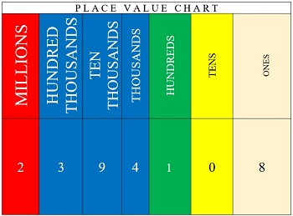
Lecture
SLIDE 4 / 14
Definition of Decimal System
IT EMPLOYS TEN DISTINCT SYMBOLS
0, 1, 2, 3, 4, 5, 6, 7, 8, 9
• The decimal system uses a base of 10 for counting
• Each symbol represents a unique quantity from zero to nine
• It is the standard system used in human daily calculations
• The system is positional, meaning value depends on digit location
• Base 10 implies ten unique digits are required for representation
• It serves as the primary reference for other number systems
Place Value Chart | Overview & Examples - Lesson | Study.com
Chandigarh University
4 / 14
Notes:
The decimal system is defined by its base of 10, meaning it uses ten distinct symbols. These symbols range from zero to nine and are the building blocks for all decimal numbers. Unlike other systems, this is the one we use naturally in daily life for counting and calculations. Its positional nature is key to understanding how computers process data later.

Slide 5
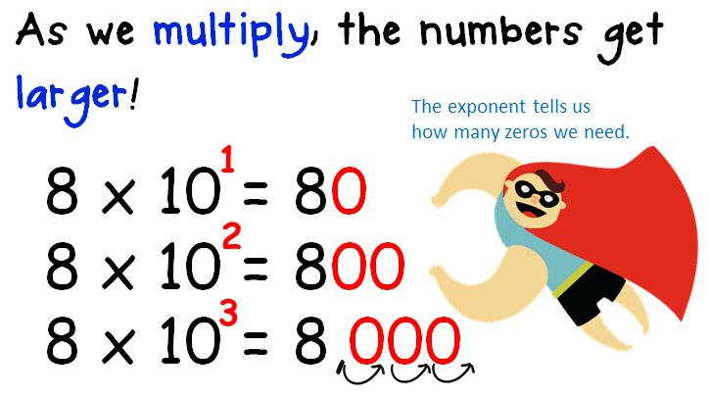
Lecture
SLIDE 5 / 14
Positional Value Concept
1
Value of a digit depends on its position relative to the radix point
2
Positions to the left represent positive powers of the base
3
Positions to the right represent negative powers of the base
4
The rightmost integer position always has a weight of 10⁰
5
Each position to the left increases the weight by a factor of 10
6
Each position to the right decreases the weight by a factor of 10
7
The radix point separates integer and fractional parts of the number
Source: peeples5.weebly.com
Chandigarh University
5 / 14
Notes:
In a positional system, the value of a digit is determined by its location. Positions to the left of the radix point represent positive powers of ten, while those to the right represent negative powers. The rightmost integer position always carries a weight of 10 to the power of zero, which equals one. This structure allows us to represent large numbers efficiently using a limited set of symbols.

Slide 6
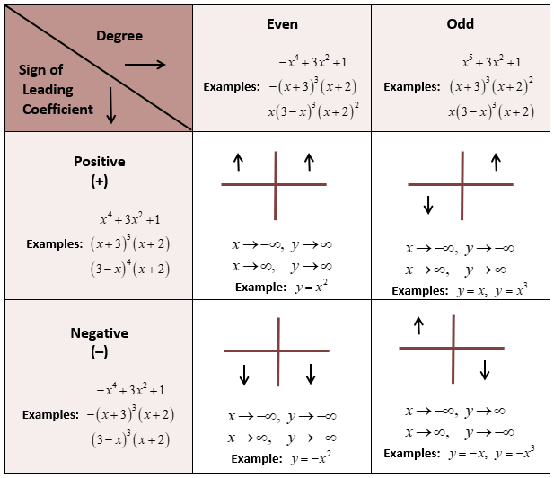
Lecture
SLIDE 6 / 14
Expanded Polynomial Form
1
Any decimal number can be expressed as a sum of products
2
Each digit is multiplied by its corresponding positional weight
3
The general form is sum of (digit × base^position)
4
This form reveals the mathematical structure of the number
5
It facilitates conversion to other number systems like binary
6
The radix point acts as the boundary between positive and negative powers
7
This representation is essential for algorithmic arithmetic operations
Source: mathhints.com
Chandigarh University
6 / 14
Notes:
We can express any decimal number as an expanded polynomial where each digit is multiplied by its positional weight. This form reveals the mathematical structure behind the number and is essential for converting to other systems like binary. For example, the number 25 is actually 2 × 10 plus 5 × 1. Understanding this structure is vital for performing arithmetic operations in digital circuits.

Slide 7
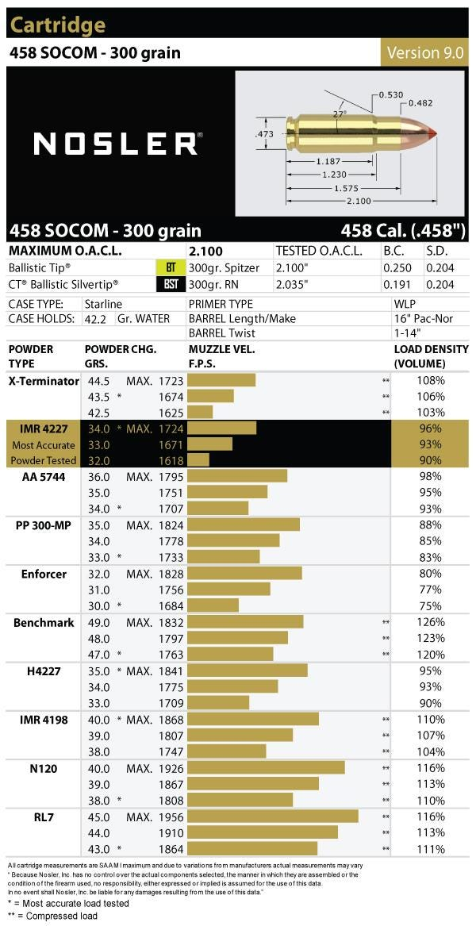
Worked Example
SLIDE 7 / 14
Integer
GOVERNING EQUATION
Calculation: (4 × 100) + (5 × 10) + (8 × 1) = 458
1
Consider the decimal number 458 to demonstrate positional value
2
The digit 8 is in the 10⁰ position with weight 1
3
The digit 5 is in the 10¹ position with weight 10
4
The digit 4 is in the 10² position with weight 100
5
This confirms the value of each digit in the sequence
6
The sum of these products reconstructs the original number
Source: www.nosler.com
Chandigarh University
7 / 14
Notes:
Let us work through the number 458 to see this in action. The digit 8 is in the ones place, so it contributes 8 × 1. The digit 5 is in the tens place, contributing 5 × 10. The digit 4 is in the hundreds place, contributing 4 × 100. Adding these products gives us 400 plus 50 plus 8, which equals 458.

Slide 8
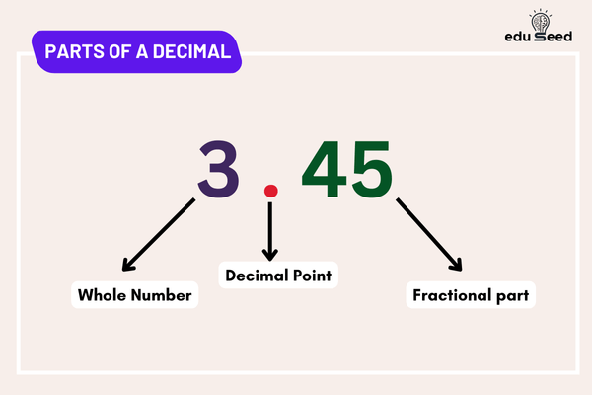
Worked Example
SLIDE 8 / 14
Fraction
GOVERNING EQUATION
Calculation: (3 × 1) + (7 × 0.1) + (5 × 0.01) = 3.75
1
Consider the decimal number 3.75 to demonstrate fractional parts
2
The digit 3 is in the 10⁰ position with weight 1
3
The digit 7 is in the 10⁻¹ position with weight 0.1
4
The digit 5 is in the 10⁻² position with weight 0.01
5
Negative powers represent fractions of the base value
6
This extends the positional concept to non-integer values
Source: eduseed.in
Chandigarh University
8 / 14
Notes:
Now let us look at a fractional number, 3.75. The digit 3 is in the ones place, contributing 3. The digit 7 is in the tenths place, contributing 7 × 0.1. The digit 5 is in the hundredths place, contributing 5 × 0.01. This demonstrates how negative powers of ten allow us to represent precise fractional values.

Slide 9

Lecture
SLIDE 9 / 14
Why Decimal Matters
1
It is the primary interface for human-computer interaction
2
Input data is often entered in decimal format by users
3
Output results are typically displayed in decimal for readability
4
Understanding decimal is essential for debugging digital systems
5
It provides a baseline for comparing other number systems
6
Most engineering specifications and standards use decimal notation
7
Conversion between decimal and binary is a fundamental operation
Source: freepixel-prod.s3.amazonaws.com
Chandigarh University
9 / 14
Notes:
Why do we study decimal if computers use binary? Because it is the primary interface for human-computer interaction. Users enter data in decimal, and we display results in decimal for readability. Understanding this system is essential for debugging digital systems and converting data between human-readable formats and machine code.

Slide 10
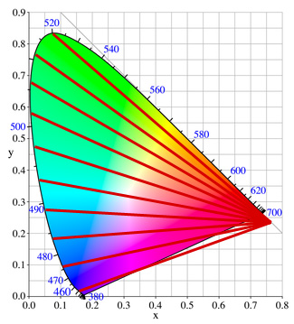
Common Pitfall
SLIDE 10 / 14
Leading Zeros
1
Leading zeros do not change the value of an integer
2
Writing 00458 is mathematically equivalent to writing 458
3
Leading zeros are often used for fixed-width formatting
4
Confusion arises when leading zeros are interpreted as octal
5
In pure decimal, leading zeros are redundant but valid
6
Trailing zeros after a decimal point indicate precision
7
Distinguish between leading zeros and significant trailing zeros
Source: www.color-blindness.com
Chandigarh University
10 / 14
Notes:
A common pitfall involves leading zeros. In pure decimal, leading zeros do not change the value, so 00458 is the same as 458. However, confusion can arise if these are interpreted as octal in programming contexts. It is important to distinguish between leading zeros, which are redundant, and trailing zeros after a decimal point, which indicate precision.

Slide 11
Common Pitfall
SLIDE 11 / 14
Radix Point
1
The radix point separates integer and fractional parts
2
In some regions, a comma is used instead of a dot
3
Misinterpreting the radix point leads to order-of-magnitude errors
4
A missing radix point implies an integer value
5
Confusion between decimal and binary radix points causes errors
6
Always verify the base when reading a number with a point
7
The position of the radix point determines the scale of the number
Chandigarh University
11 / 14
Notes:
Another common pitfall is misinterpreting the radix point. In some regions, a comma is used instead of a dot, which can cause confusion. Misinterpreting the radix point leads to significant order-of-magnitude errors. Always verify the base when reading a number with a point, as the position determines the scale of the number.

Slide 12
Common Pitfall
SLIDE 12 / 14
Place Value
1
Students often confuse the digit value with its place value
2
The digit 5 in 500 has a value of 500, not 5
3
The digit 5 in 0.05 has a value of 0.05, not 5
4
Failing to multiply by the positional weight causes calculation errors
5
Always identify the power of ten for each digit position
6
Place value is the product of the digit and its weight
7
This distinction is critical for accurate arithmetic operations
Chandigarh University
12 / 14
Notes:
Students often confuse the digit value with its place value. The digit 5 in 500 has a value of 500, not 5. Similarly, the digit 5 in 0.05 has a value of 0.05. Failing to multiply by the positional weight causes calculation errors. Always identify the power of ten for each digit position to ensure accuracy.

Slide 13
Lecture
SLIDE 13 / 14
Key Takeaways
1
Decimal is a base-10 positional system using digits 0-9
2
Value depends on position relative to the radix point
3
Expanded polynomial form reveals the mathematical structure
4
Leading zeros are redundant but valid in decimal notation
5
Understanding decimal is essential for human-computer interaction
Chandigarh University
13 / 14
Notes:
To summarize, the decimal system is a base-10 positional system using digits zero through nine. The value of a digit depends on its position relative to the radix point. We use expanded polynomial forms to reveal the mathematical structure of numbers. Finally, understanding decimal is essential for effective human-computer interaction.

Slide 14
Lecture
SLIDE 14 / 14
References
COMPUTER ORGANIZATION AND DESIGN
The Hardware/Software Interface — David A. Patterson, John L. Hennessy
COMPUTER ARCHITECTURE
A Quantitative Approach — John L. Hennessy, David A. Patterson
• Computer Organization and Architecture — William Stallings
• Computer System Architecture — M. Morris Mano & Rajib Mall
• Computer Organization — Carl Hamacher, Zvonko Vranesic, Safwat Zaky
Chandigarh University
14 / 14
Notes:
For further reading, please refer to the standard textbooks listed on this slide. These resources provide comprehensive coverage of number systems and digital logic. I encourage you to consult these references to deepen your understanding of the material covered today.

